Slide 1
Building Microsoft Graph applications
Build an Azure Function using Microsoft Graph

Slide 2

Build an Azure Function using Microsoft Graph
Application registration
Grant user consent
Grant admin consent
Create the Azure Function project
Authentication without a current user
Debugging Azure Functions locally
Publish Azure Functions to Azure
Monitor Azure Functions in Azure

Slide 3
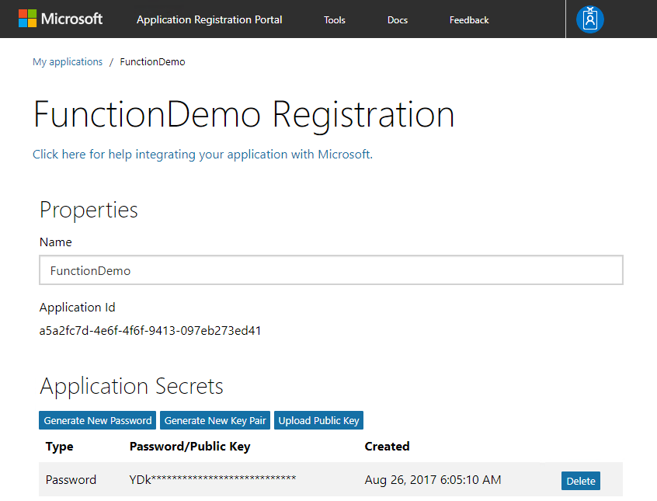
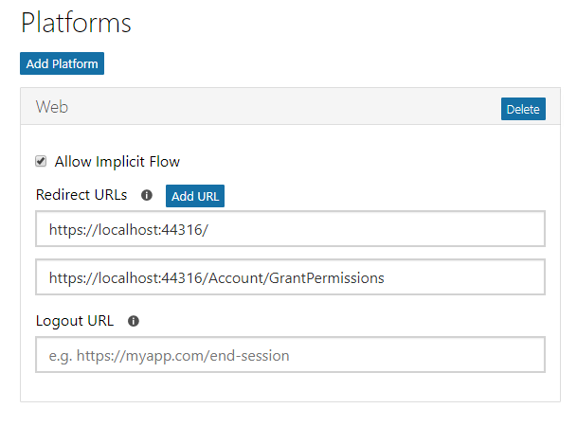
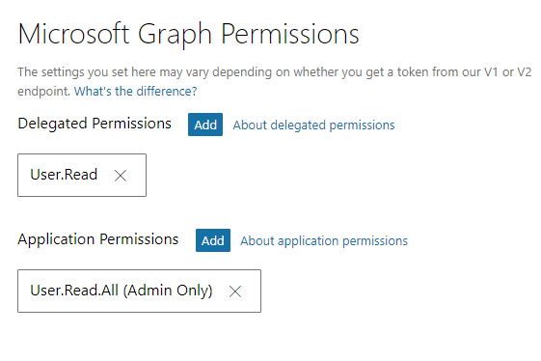
Application registration
Create an application
Create an application and generate an application secret. Copy the application ID and secret.
Add web platform
Add a Web platform. Enable “Allow Implicit Flow”, and provide two redirect URLs.
Specify permissions
The application needs the User.Read.All permission which requires admin consent.
Notes:
In the previous examples, users could consent to the requested permissions. This application runs without an interactive user and requires admin consent to act without a user.

Slide 4
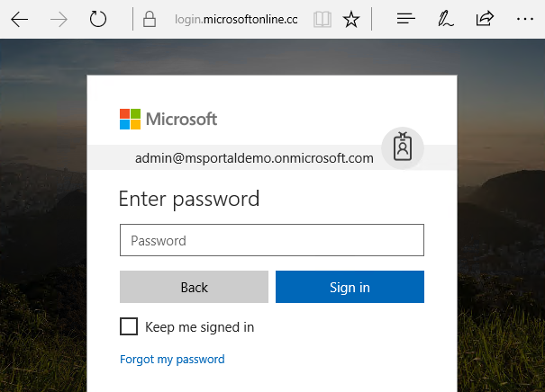
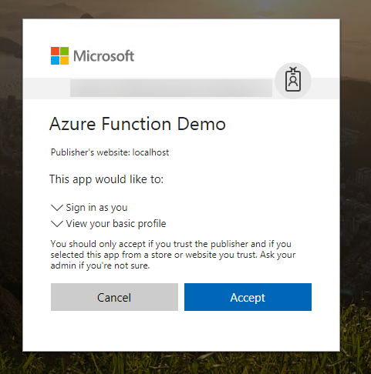
Grant user consent
User is prompted to sign in
The user is prompted to sign in within the browser. Once signed in, the user is redirected back to the application’s reply Url.
User is prompted for user consent
The user is prompted for consent to permissions that do not require administrator consent.

Slide 5
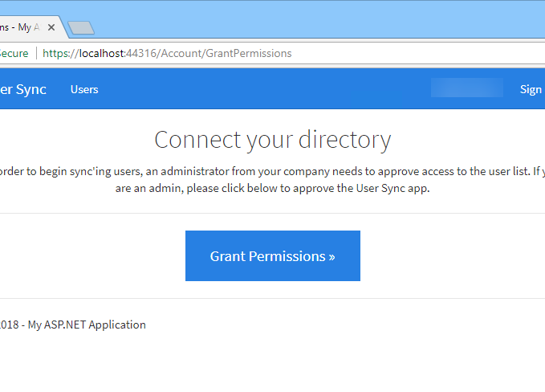
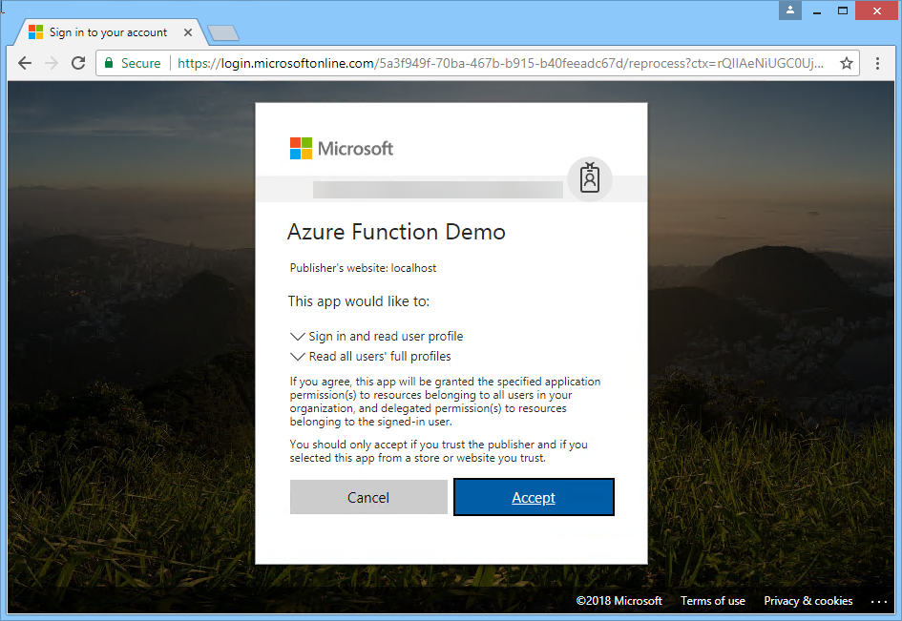
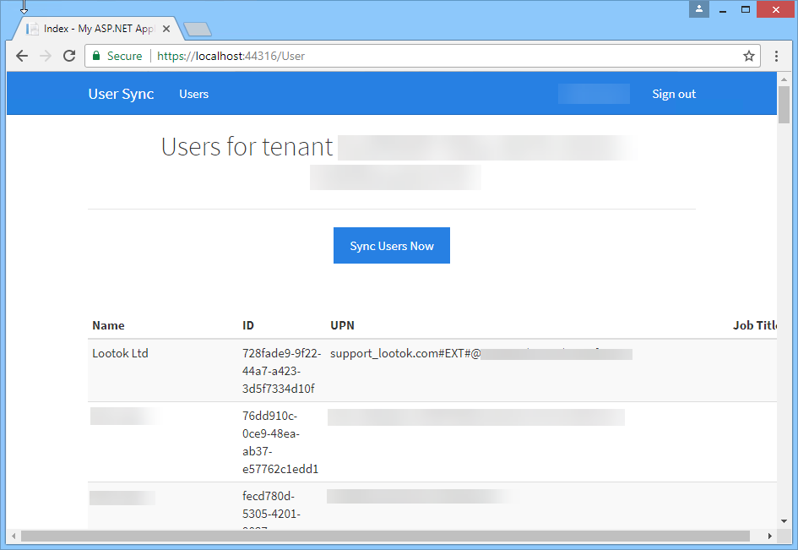
Grant Admin Consent
Click the “Grant Permissions” button
Click the “Grant Permissions” button to prompt for admin consent.
Grant admin consent
The administrator is prompted for admin consent.
Test admin consent
Once granted, confirm the app has the required permissions by clicking the button. The confirms the app can now run without an interactive user.
Notes:
The web application project and interactive user sign on is not strictly required, the user could simply go to the endpoint:
https://login.microsoftonline.com/common/adminconsent?client_id=<your client id>
The web application is used here to confirm the token permissions have propagated before continuing.
Note that there is currently a lag time of approximately 30 minutes between the time when administrator consent is granted and data replication first succeeds. For more information, see:
https://github.com/Azure-Samples/active-directory-dotnet-daemon-v2/issues/1

Slide 6
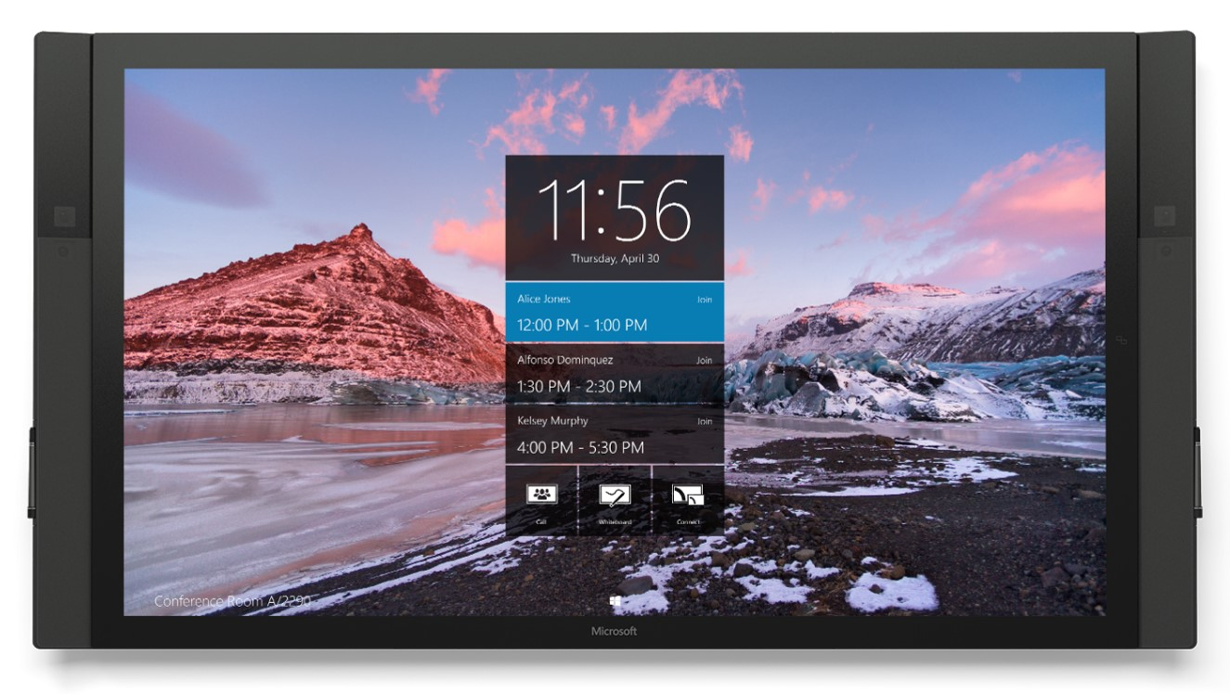
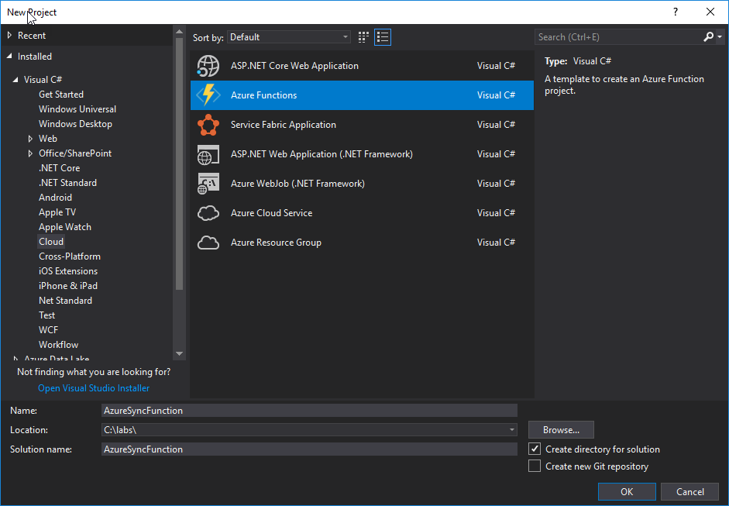
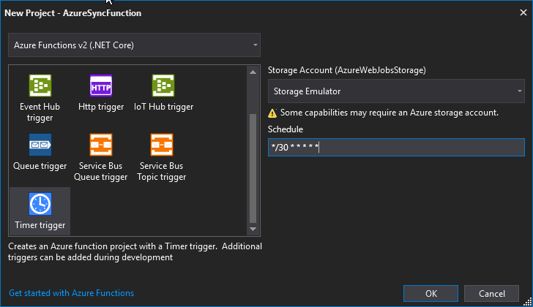
Create an Azure Function project
Notes:
Visual Studio 2017 introduces new tooling for Azure Functions, providing a project template to quickly create functions, debug locally, and publish to an Azure subscription. Choose from a trigger such as a timer trigger to generate the code. Add NuGet packages as shown in other sections.

Slide 7


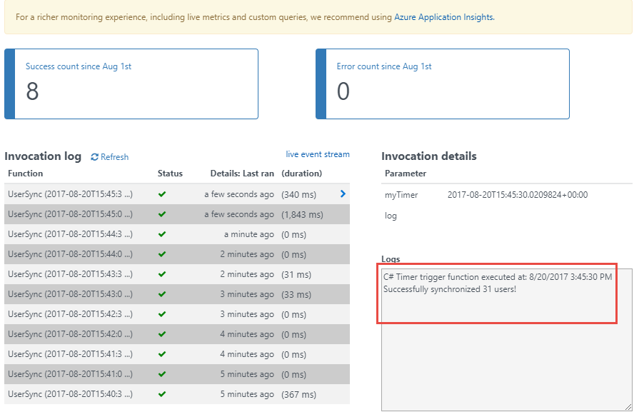
Overview of the sample
Get token
Access token
Teams
Groups
Tasks
Chats
Calendar
Files
Get all users
Insights
Microsoft Graph
All users
Messages
Coworkers
User
Meetings
Devices
People

Slide 8
Daemon applications – client credentials grant
https://login.microsoftonline.com/common
Application
/common/OAuth/v2.0/token
/adminconsent
https://graph.microsoft.com
?client_id=…&redirect_uri=…
Tenant ID
?client_id=…&client_secret=…
access_token
/v1.0/user (access token)
All users in directory
Notes:
Daemon, server to server, or “headless” applications
Examples are applications that run on a scheduled basis and do not have an interactive user. An admin still needs to grant consent to the app.
Example of requesting admin consent:
https://login.microsoftonline.com/common/adminconsent?client_id=6731de76-14a6-49ae-97bc-6eba6914391e&state=12345&redirect_uri=http://localhost/myapp/permissions
Once an admin has granted consent, there is no more user interaction required. The application provides its client credentials to obtain a fresh token.

Slide 9
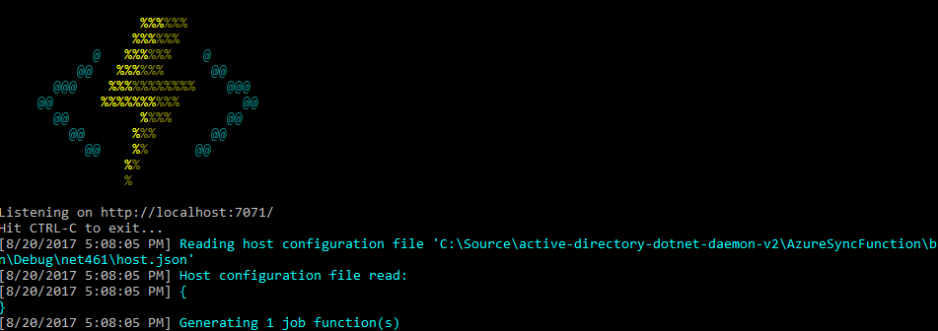
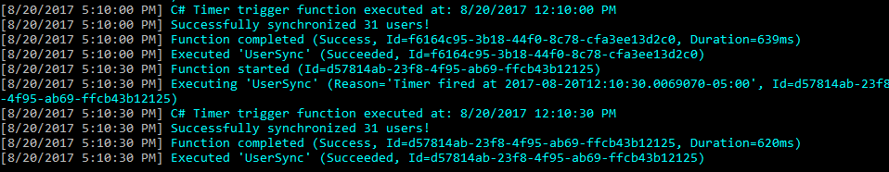
Debugging Azure Functions locally
Notes:
Functions can be debugged locally. Output is directed to a console window where any log messages are visible, such as our message “Successfully synchronized 31 users!”

Slide 10
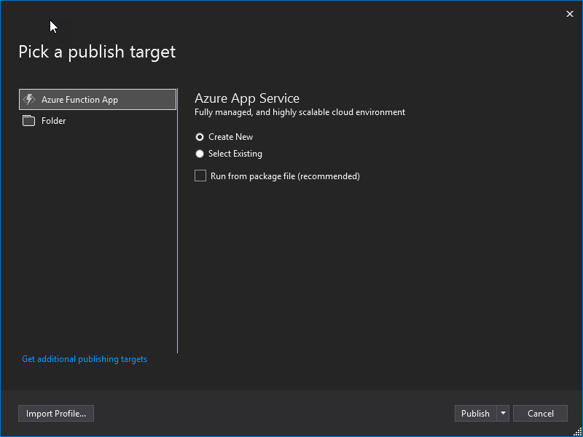
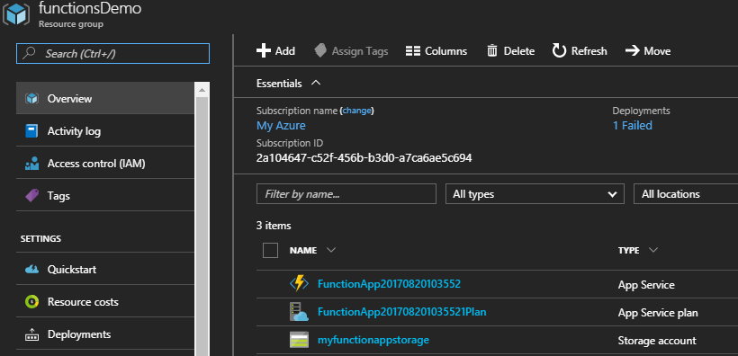
Publishing to Azure
Notes:
Publishing to Azure is simple using the wizard in Visual Studio 2017. Once published to Azure, manage it via the portal or CLI like any other resource.

Slide 11

Monitoring Azure Functions in Azure
Notes:
The Azure Function runs on a scheduled basis, and you can easily view the Log messages.

Slide 12
Demo

Slide 13
Scenarios where this is useful
Teams
Groups
1
Synchronization apps that need to read data from an API to create reports or compare to another system.
Apps that need to perform work without an interactive user.
Scheduled jobs that perform work without an interactive user.
Tasks
Chats
Calendar
Files
2
Insights
Microsoft Graph
3
Messages
Coworkers
User
Meetings
And many more…
People
Devices
Notes:
While this section refers to a very simple scenario, it’s not hard to imagine the new capabilities that you could add to an existing application or new scenarios. Using just JavaScript, you could build an application that gathers intelligence on individuals invited to a meeting such as the files they are working on, the groups they belong to, and people that are common to each of you.

Slide 14
Thank you.

